Slide 1
Menstrual Hygiene Management
Case study and best practice in global context
Thérèse Mahon - WASH in Education & MHM Specialist, WaterAid UK
Jan-Christoph Schlenk - Advisor, Sustainable Sanitation Programme, GIZ

Slide 2
Menstrual health and hygiene – linkage to SDG6 and WASH in Health Care Facilities
SDG6.2: By 2030 achieve access to adequate and equitable sanitation and hygiene for all …, paying special attention to the needs of women and girls and those in vulnerable situations
Menstrual hygiene management defined by WASH sector. Shift towards menstrual health to incorporate multi-sectoral approach addressing menstruation as a public health and gender equality issue.
Health sector role in integrating inclusive menstrual health in sexual reproductive health, WASH in HCF and addressing menstrual disorders and other types of vaginal bleeding.
Notes:
MHM definition ‘women and adolescent girls using a clean menstrual management material to absorb or collect blood that can be changed in privacy as often as necessary for the duration of the menstruation period, using soap and water for washing the body as required, and having access to facilities to dispose of used menstrual management materials. They understand the basic facts linked to the menstrual cycle and how to manage it with dignity and without discomfort or fear’

Slide 3
SDG 6.2 – JMP core indicators for
WASH in HCF and MHM
2.1.2 Basic sanitation services in healthcare facilities:
  health care facilities with improved and usable sanitation facilities, with at least one toilet dedicated for staff, at least one sex-separated toilet with menstrual hygiene facilities, and at least one toilet accessible for users with limited mobility.
A toilet can be considered to have menstrual hygiene facilities if it
  has a bin with a lid on it for disposal of used menstrual hygiene products, and
  water and soap available in a private space for washing.
Notes:
Ref: Core questions and indicators for monitoring WASH in health care facilities in the Sustainable Development Goals
https://washdata.org/sites/default/files/documents/reports/2019-04/JMP-2018-core-questions-for-monitoring-WinHCF.pdf

Slide 4
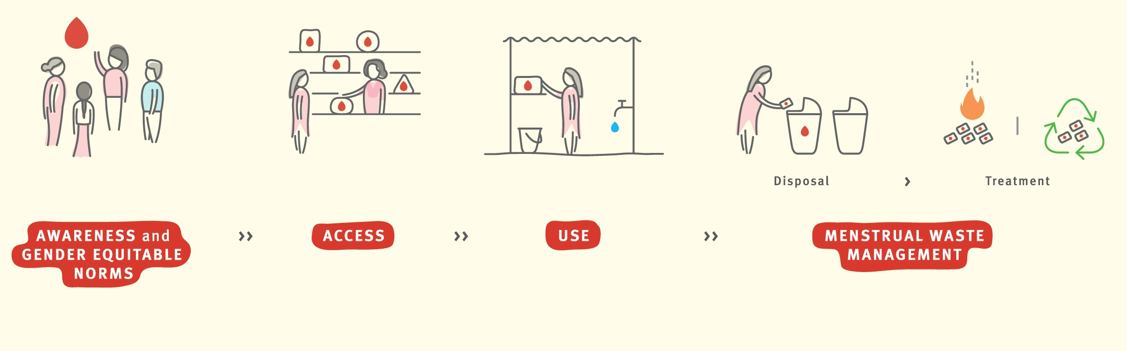
Management of Menstrual Waste
Lessons from India
Notes:
Menstrual materials – service chain
Reference Menstrual Health Alliance India and WaterAid India

Slide 5
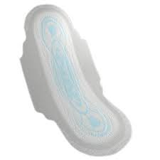
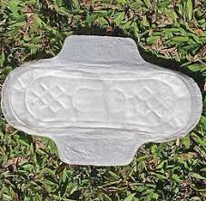
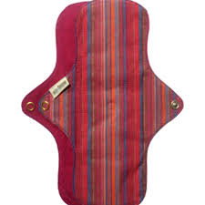
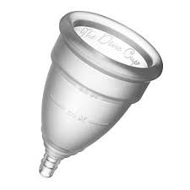
Menstrual Hygiene Products in India
Menstrual hygiene product use volume
Environmental impact
Non-compostable
Compostable
Reusable
Menstrual Hygiene Waste Volume
Notes:
There are three axes here: the Y axis on the left is the volume of the product used, the x axis at the bottom is the waste volume generated by each product, and the third axes on the right is the environmental impact.
If we place the different types of products along these axes, this is what we see: reusables have the lowest use volume (as they are reused), have the lowest waste volume and have the least environmental impact.
Compostable products, since they are disposable, have low usage volume and higher waste volumes than reusable, however, their compostable nature means that the waste degenerates fairly quickly and causes the least environmental impact.
In terms of disposables, non compostable products have the highest usage and waste volume, and highest environmental impact in terms of waste.

Slide 6
Understanding Menstrual
Waste Management
Menstrual waste
Blood and used menstrual absorbents, including cloth, disposable sanitary napkins, tampons, and other substances or materials
Classification of menstrual waste
The Solid Waste Rules (2016) consider menstrual waste as solid waste and define it as sanitary waste
Rules specify responsibilities of the waste generator, local authorities and gram panchayats and producers of sanitary products
Safe Management of Menstrual Waste
Series of steps, treatment and disposal of used absorbents in a manner that does not cause harm to girls and women (the user) and to the environment (in terms of land, air and water sources)
Notes:
When looking at menstrual waste as solid waste – waste segregation becomes a central component – without this, it is difficult to deal with menstrual waste effectively.
Segregation of waste can happen at several levels, but importantly at the user level, and then again when waste is sorted at central facilities for further processing. Segregation then primes the waste for further treatment and final treatment.
Once menstrual waste is segregated, it can be processed in different ways. Before delving into waste management solutions, let us understand what menstrual waste management means.
Menstrual waste comprises of blood and used absorbents – that may of different materials as we saw.
The Solid Waste Rules 2016, clearly classify menstrual waste as solid waste calling it sanitary waste. The rules specify responsibilities of the waste generator (me), the local authorities and gram panchayats (in terms of what types of IEC they can do to spread awareness), and on the manufacturers (provide covers for waste).
The safe management of menstrual waste implies a series of steps, with a focus on the treatment and final disposal of used materials in a way that causes least harm to the environment and to the women.

Slide 7


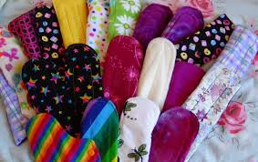
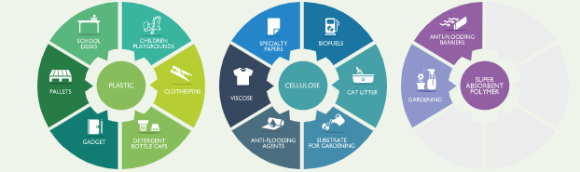
Effective Treatment of
Menstrual Waste
Use of reusable menstrual products
Reduce Waste
Compost
Incinerate
Transform waste
Sterilize Waste
Recycle
Autoclave
Chemical treatments
This waste will require further treatment
and disposal post sterilization

Slide 8
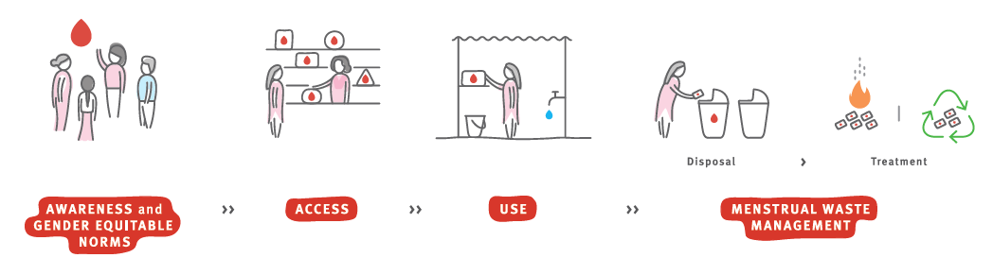
Effective Implementation
Comprehensive Programming
IEC strategy
INDICATORS
Monitoring and Evaluation
Capacity building
Notes:
Moving from the theoretical to the practical – how do we begin to operationalize plans for menstrual waste management?
First of – we need to keep in mind that MH programs must address issues across the value chain – from awareness to waste management. IEC strategy, Capacity building of field staff and district administration, and indicators for monitoring must be along this value chain.
Ensuring people can make informed choice in relation to the menstrual materials they use according to their preference and context – with the information, regulation and services required to use them safely and sustainability (personal and environment).

Slide 9
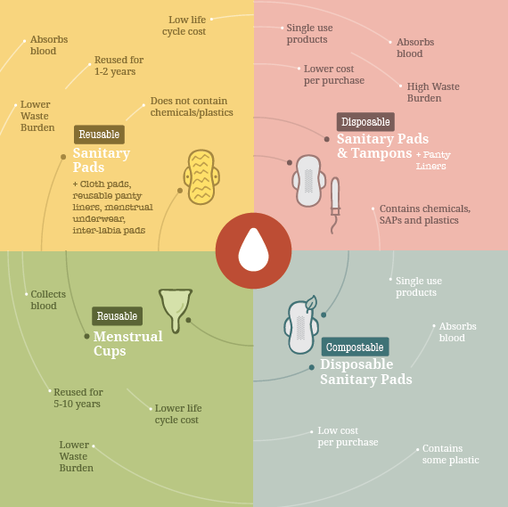
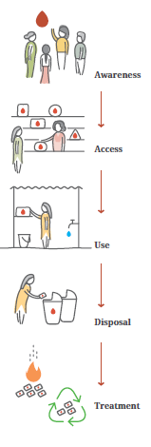
Informed choice of menstrual materials
Hygienic use of any menstrual absorbent calls for the following:
• Use of safe, hygienic menstrual hygiene materials
• Regular changing of menstrual hygiene materials four times a day
• Daily bathing and washing of genitals with water (use of harsh soaps to be avoided)
• Proper washing, drying and storage of reusable cloth pads and menstrual cups
Notes:
Awareness generation on menstrual hygiene management has typically focused on use of just sanitary pads. A vast majority of products reaching women and girls through government and large manufacturers are made primarily of noncompostable materials – materials that take hundreds of years to degrade. Apart from the amount of waste generated, when women and girls do not have easy access to disposal options, they tend to wear a pad for much longer than they should, putting them at risk for unnecessary and avoidable discomfort and health issues. We need better solutions that minimise health risks and allow us to deal with all waste effectively.
References and resources:
https://www.wateraidindia.in/sites/g/files/jkxoof336/files/informed-product-choice-and-disposal_1.pdf
https://www.wateraidindia.in/sites/g/files/jkxoof336/files/menstrual-waste-management.pdf

Slide 10
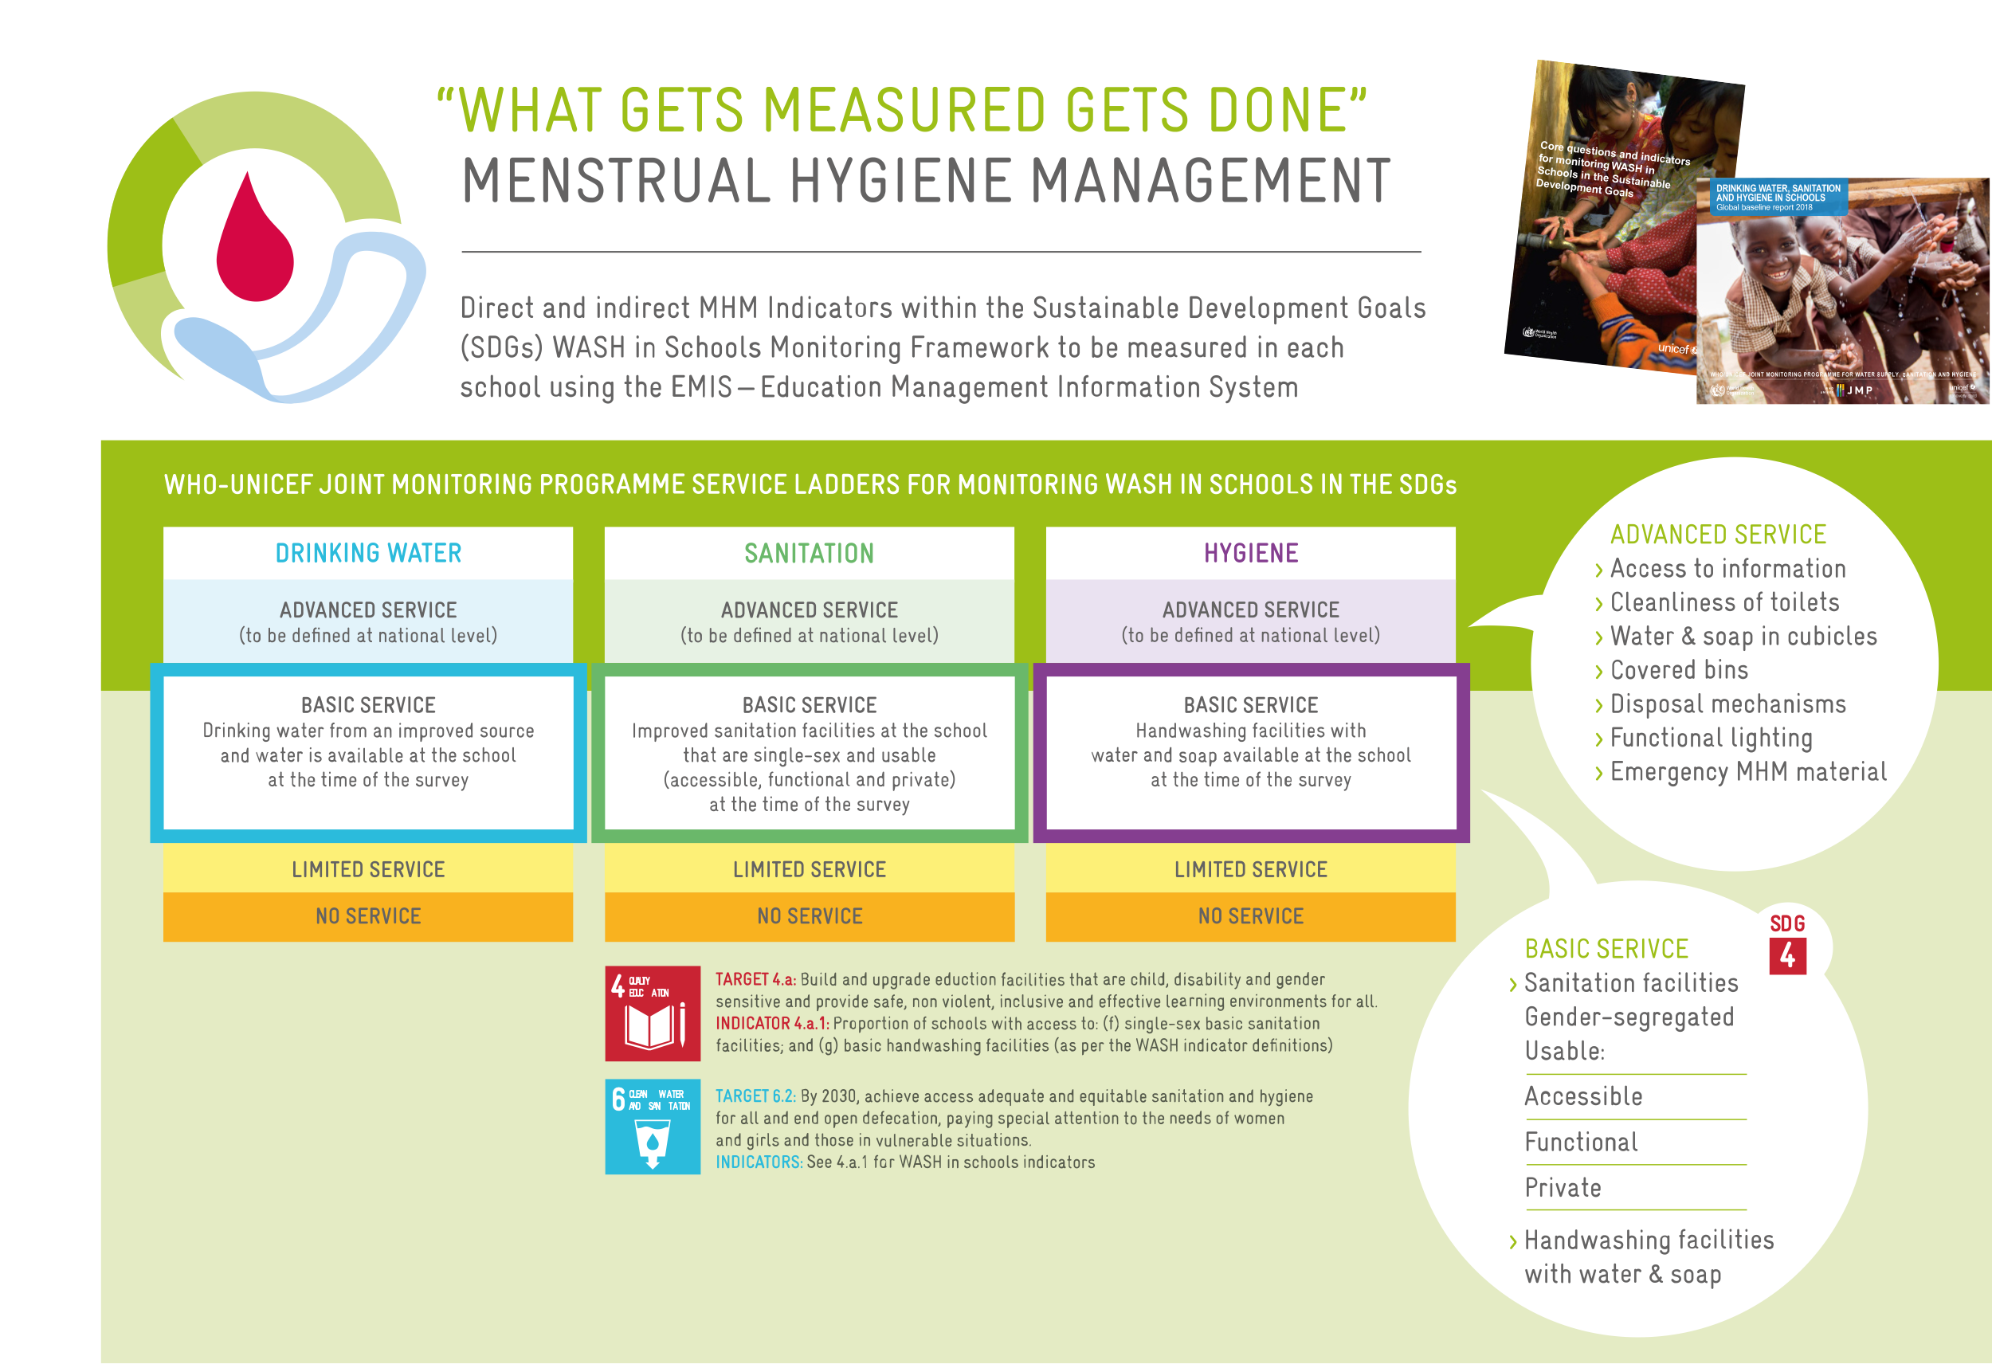

Slide 11
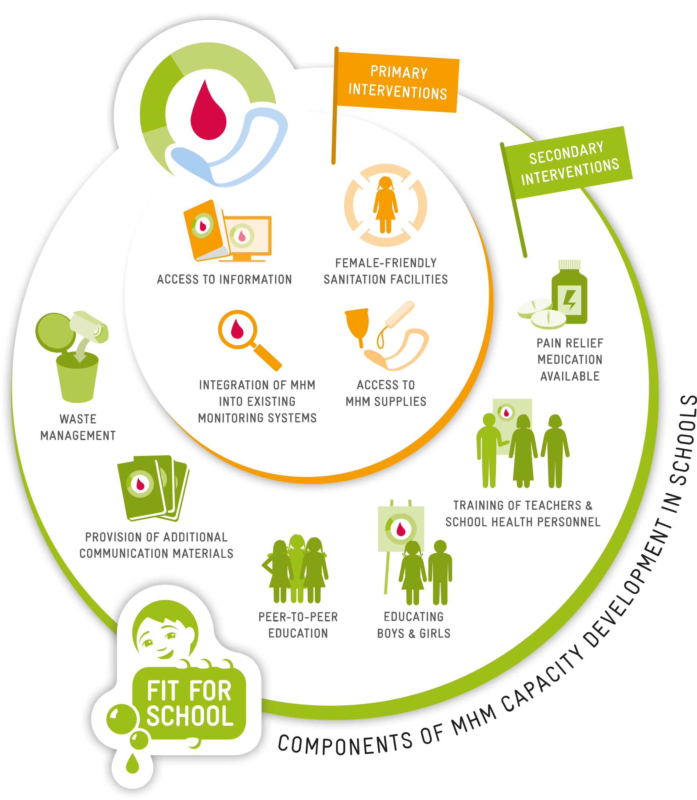

Slide 12
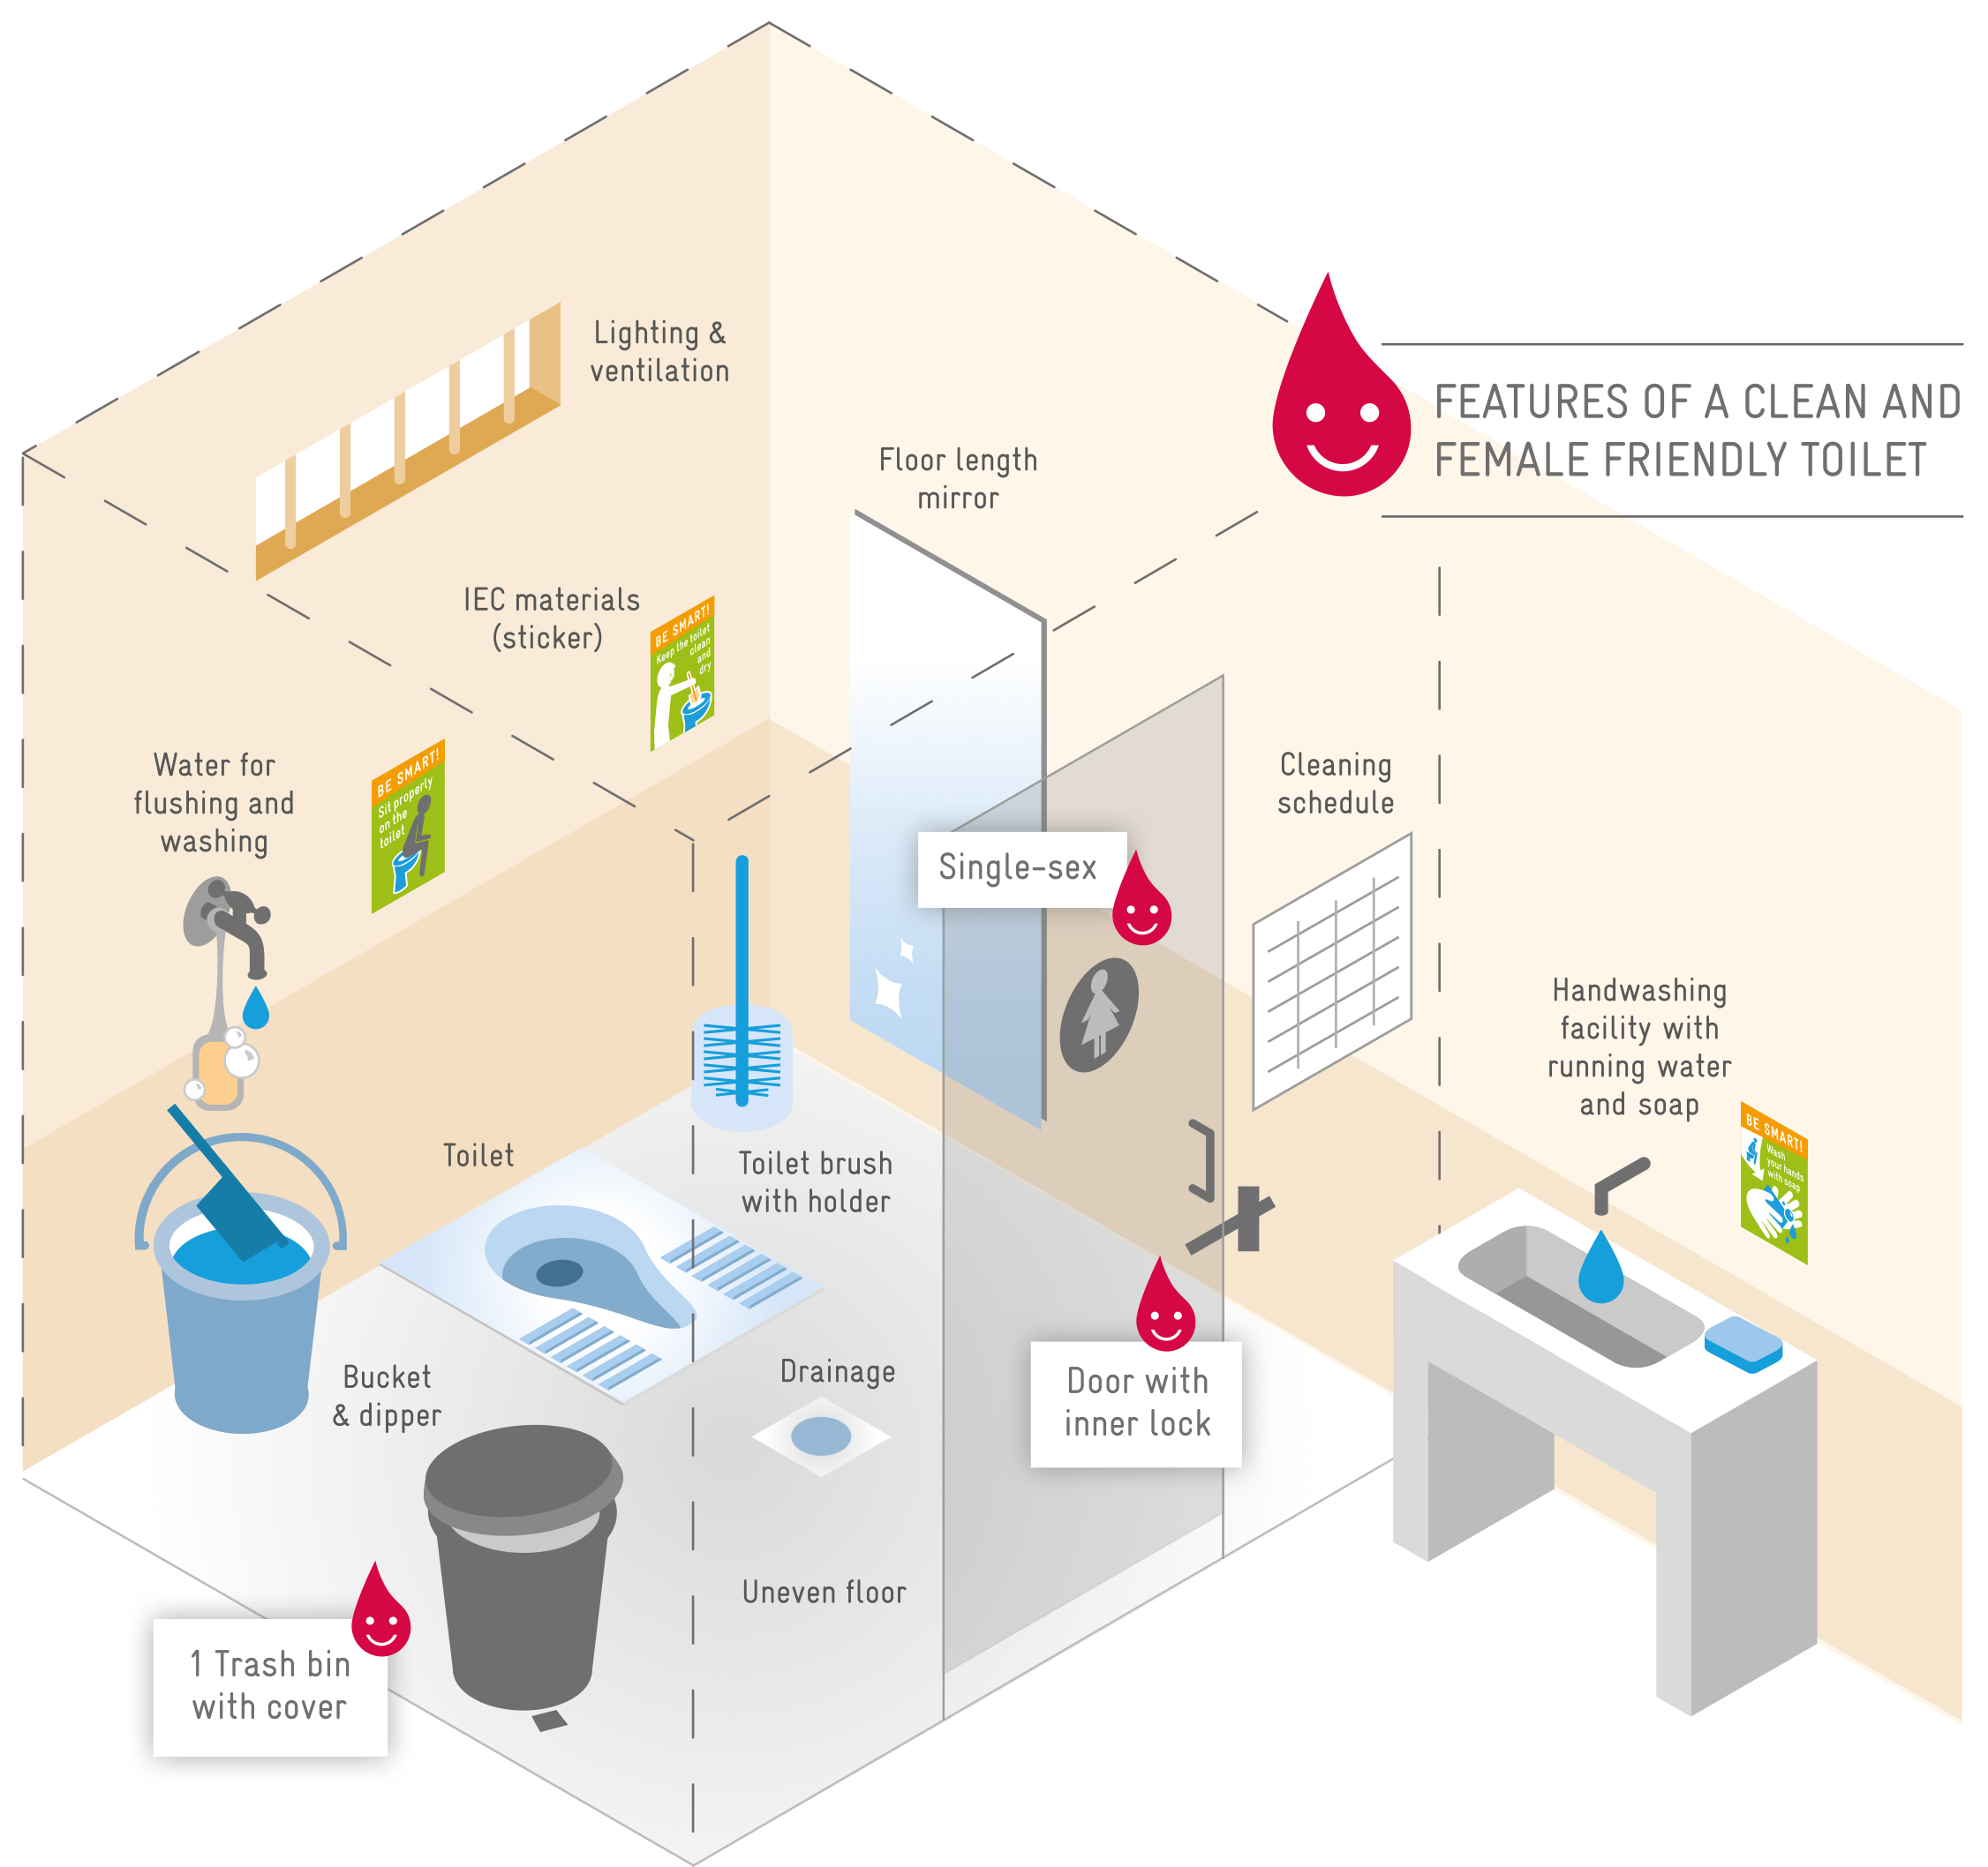

Slide 13
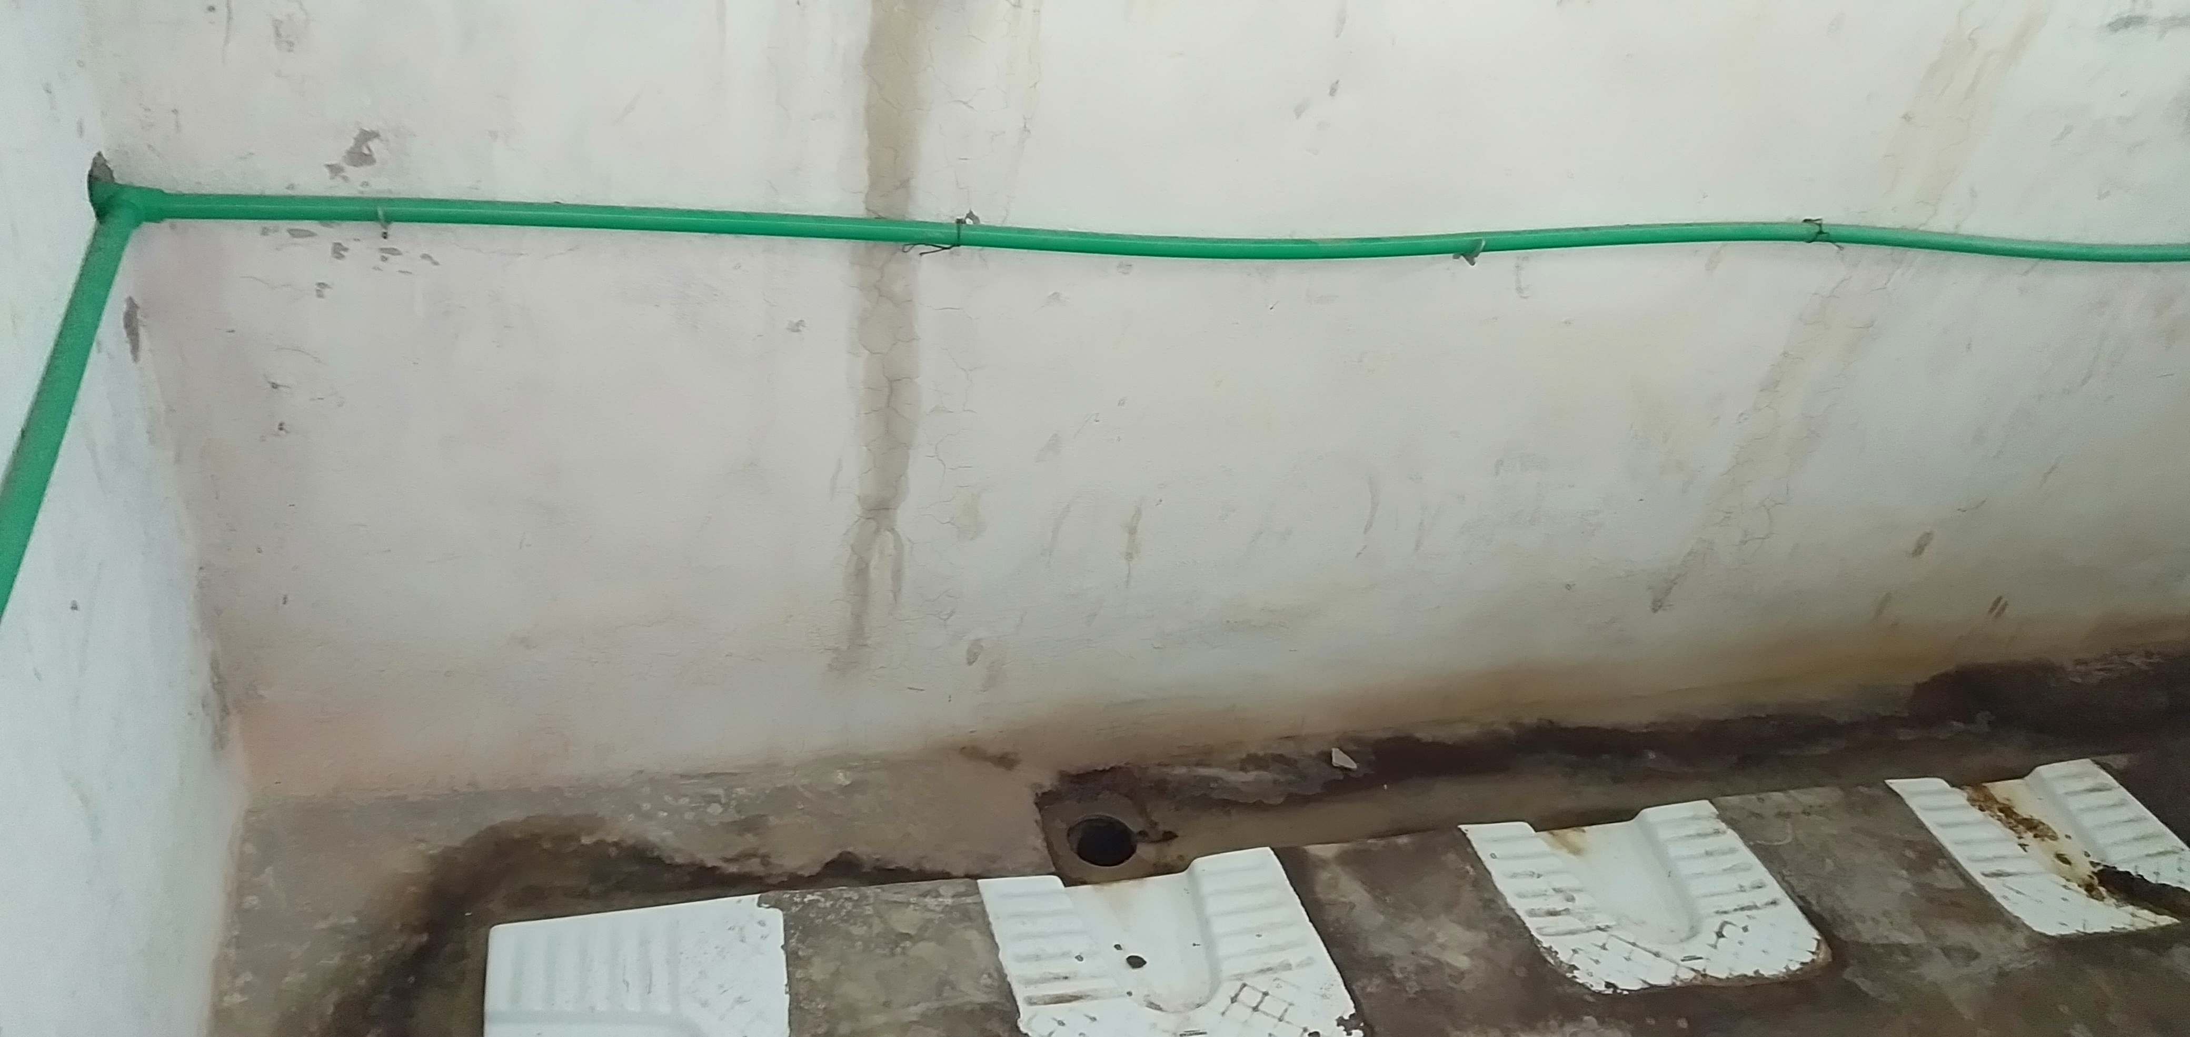
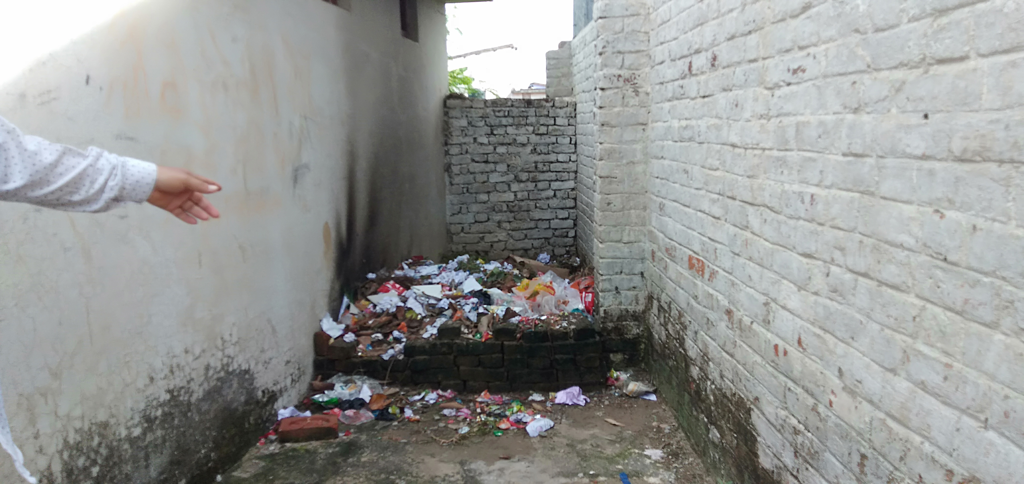
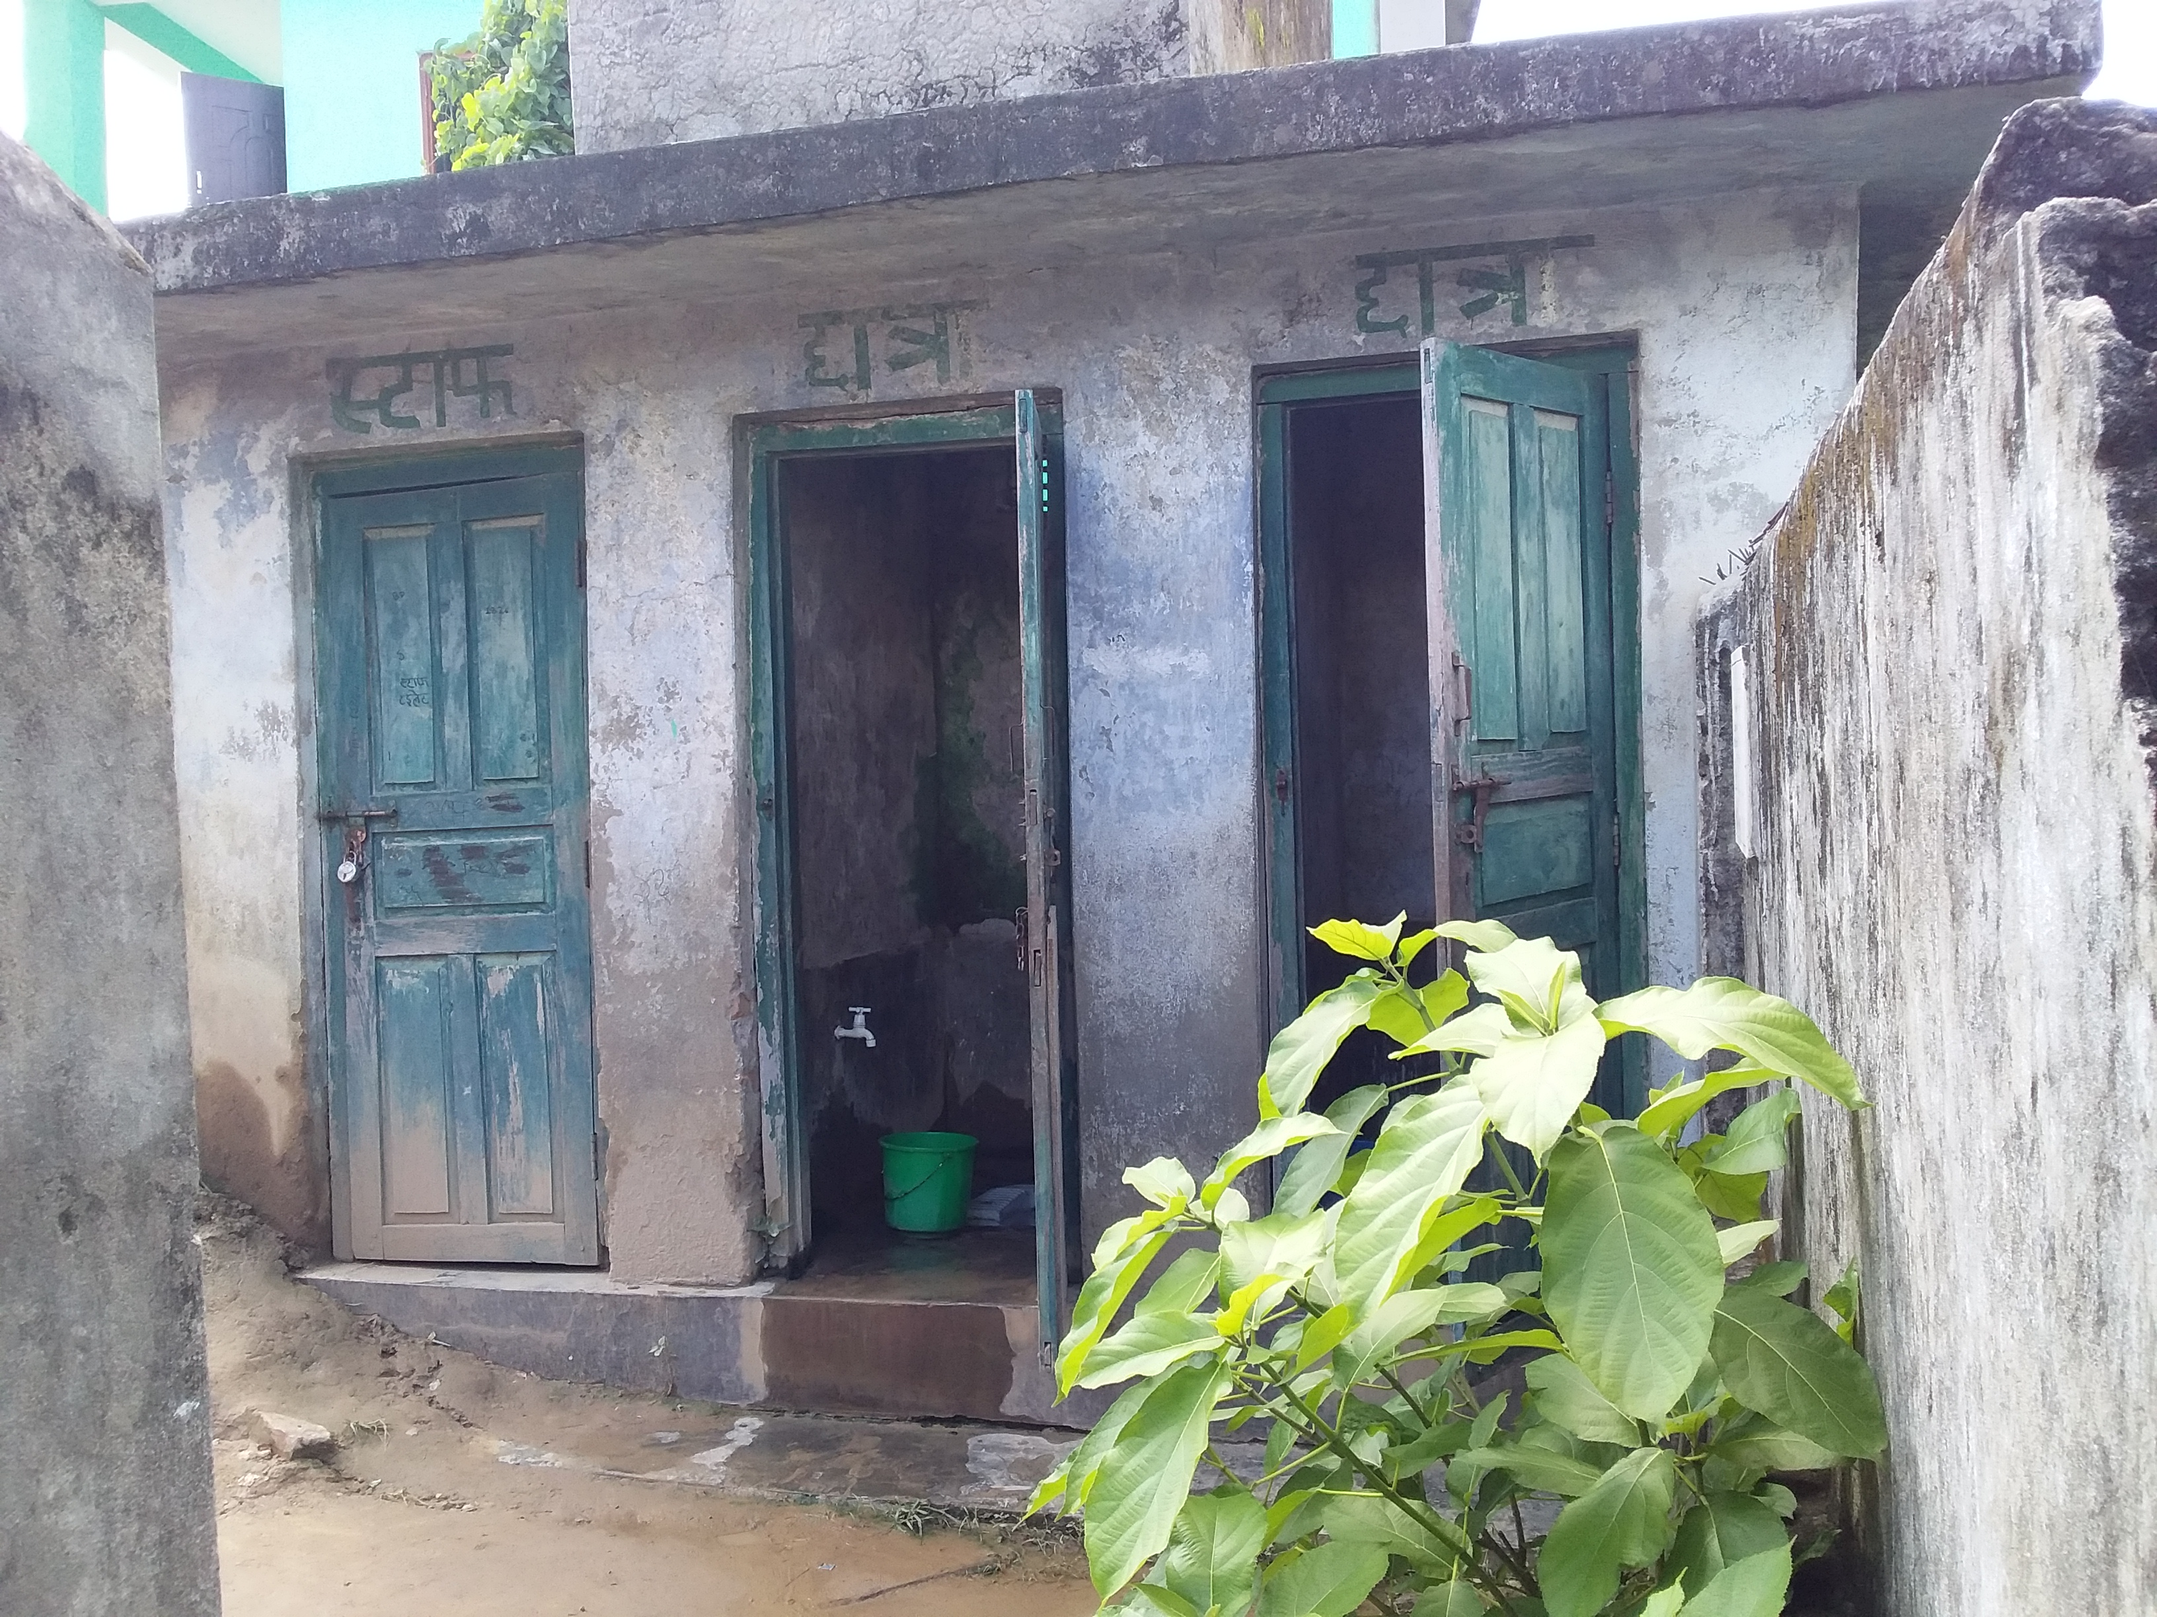
MHM in Schools in Nepal
Re-construction of 17 female-friendly Toilet blocks inlcuding waste management in Province 7(Dhangadhi & Godawari) by GIZ S2HSP

Slide 14

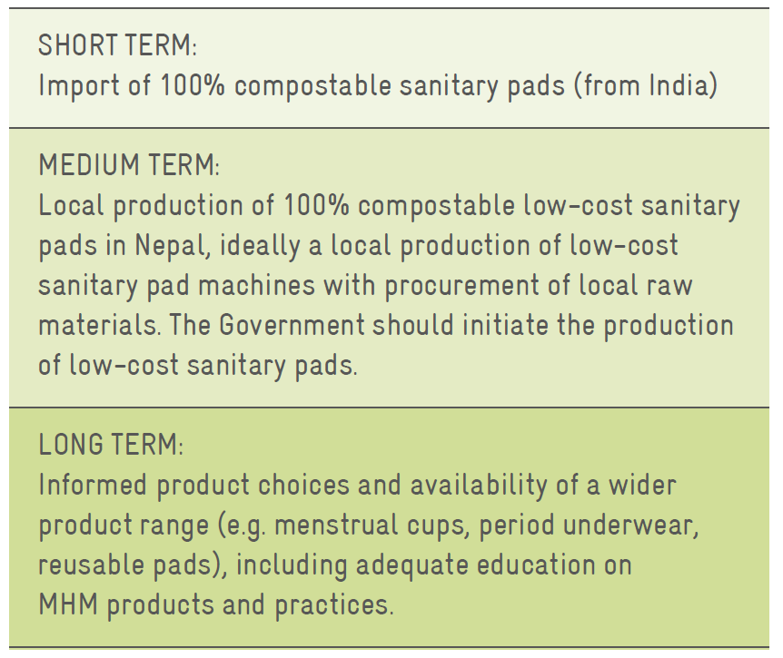

Slide 16
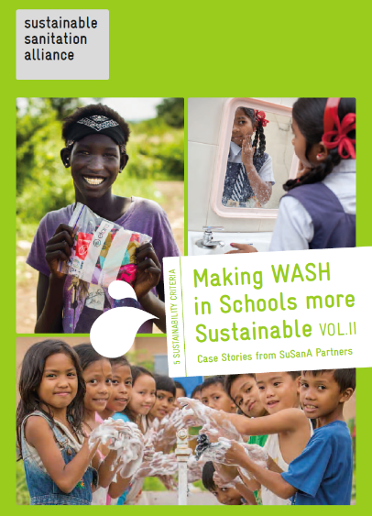
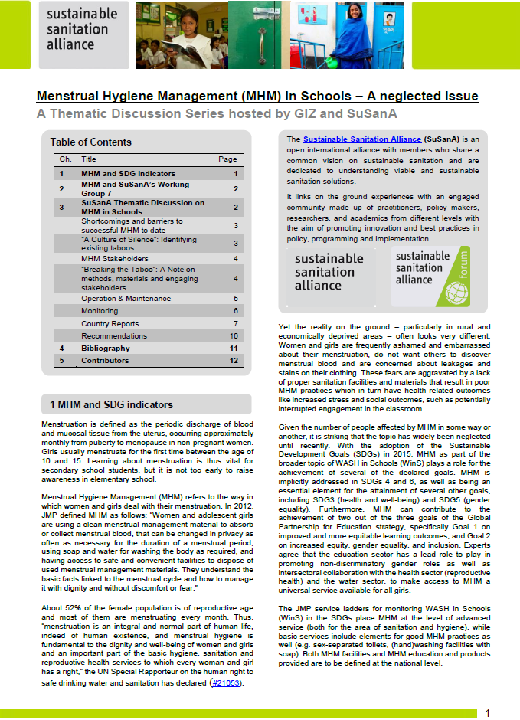
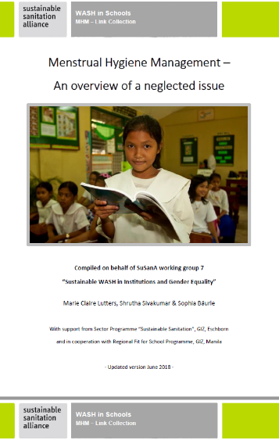
MHM-related Activities of the
Sustainable Sanitation Alliance (SuSanA)
Link-Collection
Collection of Case Stories
from SuSanA Partners
Thematic Online Discussion

Slide 17
Recommendations
Promote informed choice of menstrual materials
Integrate menstrual waste into the solid waste management service chain and test disposal solutions
Work with the private sector (across the menstrual health service chain – information/awareness, access to products, disposal)
Notes:
Develop and promote acceptable and affordable reusable and compostable products
Ensure national quality and safety standards of menstrual products (including imports)

Slide 18
Menstrual Hygiene Management
Question and answer session

Slide 19
Guiding Question
How to improve the menstrual waste management?
Notes:
How to work collaboratively (multisectoral including all the concerned ministries, water and sanitation, health, education and women and children) for proper menstrual waste management?
How to ensure all sanitation facilities in public intuitions, especially schools should be made female/MHM friendly (availability of bin and other suitable infrastructure)?
How to develop and mainstream environment friendly waste management system for menstrual waste in all settings in Nepal?
How to promote sustainable, affordable and environmental-friendly MHM products ?
-e.g: Biodegradable pads and its disposal
Promote the use of reusable menstrual product
How to integrate monitoring of menstrual waste management into existing M & E system to ensure sustainability?

